Slide 1
Taking Measures
Jenkins CI User Event – CPH 2014
Robert Sandell – Software Environment and Product Configuration – Sony Mobile Communications
© Sony Mobile Communications

Slide 2
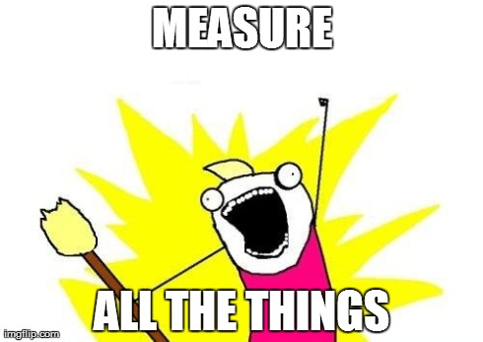
Background
TODO

Slide 3
Disclamer / Explanation
We chose to measure externally as much as possible
If Jenkins is misbehaving you might not get to the monitoring page to find the data you want.
Measuring something new might require plugin update which requires Jenkins restart
Plugins (10 min browsing on the wiki)
Disk Usage
Build Failure Analyzer
Global Build Stats
JQS Monitoring
Monitoring (Java Melody)
Graphite-plugin
Dashboard View

Slide 4
Graphite in short
http://graphite.readthedocs.org/
Graphite is an enterprise-scale monitoring tool that runs well on cheap hardware. It was originally designed and written by Chris Davis
Graphite does two things:
Store numeric time-series data
Render graphs of this data on demand
Feeding data into Graphite is simple
echo "local.random.diceroll 4 `date +%s`" | nc -q0 graphite.your.com 2003

Slide 5
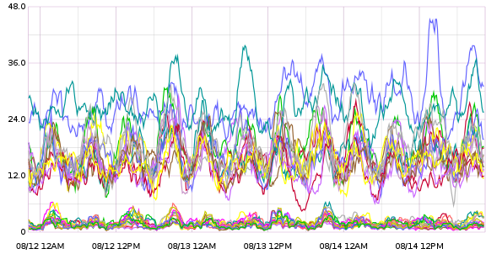
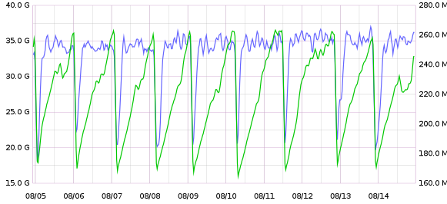
Collectd - for the fundamentals
https://collectd.org/
collectd is a daemon which collects system performance statistics periodically and provides mechanisms to store the values in a variety of ways, for example in RRD files.
Or in our case; sending the data from our masters to a grapite server.
Graphite can read the RRD format so we are also experimenting with rsync of the local dbs on each slave.
It has Java and JMX plugins
So we can also get data like heap, threads and gc.
But also from Tomcat like no. of requests and bytes sent.
movingAverage(jenkins.seld.regular.cpu.*.cpu.user,100)
Used Heap
Perm-Gen on secondary axis

Slide 6
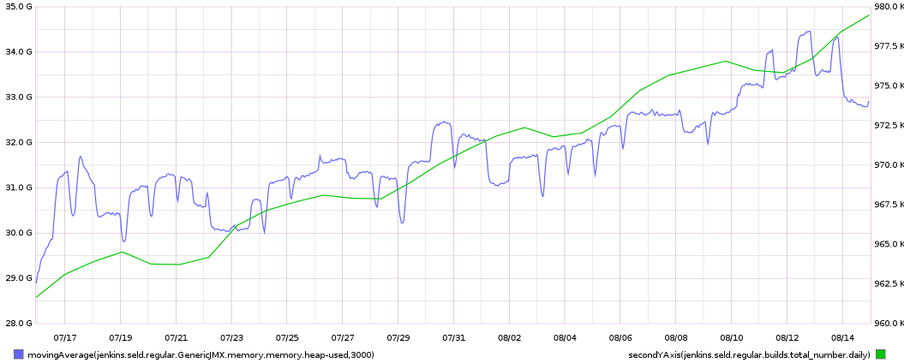
Heap over a month

Slide 7
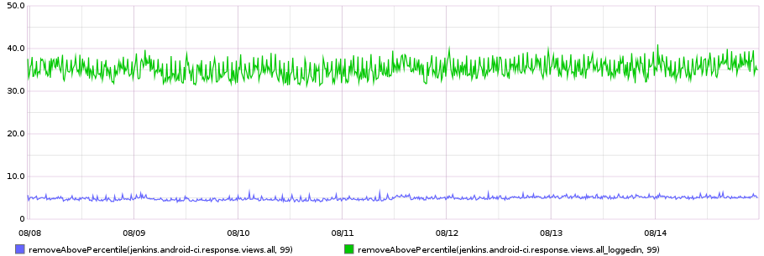
Response time
How long does it take to get the all jobs view, using plain old curl
Put this into Nagios and you have the beginnings of an early warning system

Slide 8
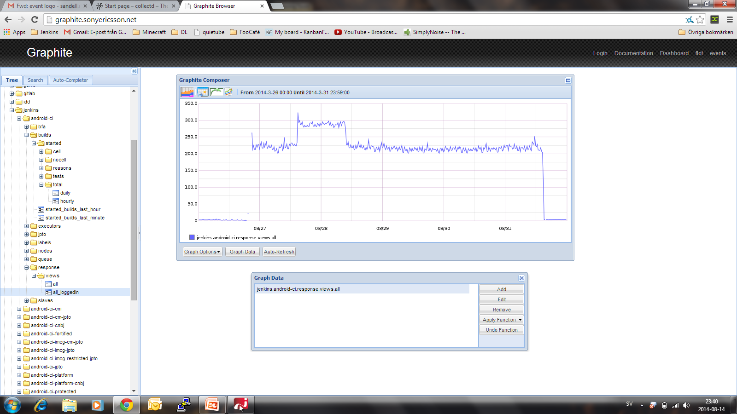

Lesson: You should also measure your staging servers, or this might happen.
v. 1.532.2
v. 1.480.2
Patched!

Slide 9
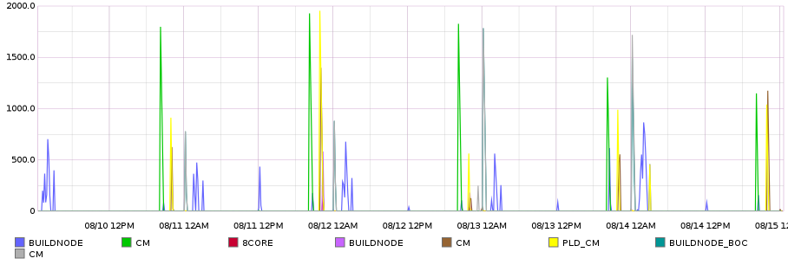
Queue time
How long does a build stay in the queue before it can start
One ”kicker” job scheduled to run on master every 10 min.
The kicker starts a parameterized job for each interesting label with a node label parameter so it runs on that label.
And a ”simple” Scriptler build step in the downstream build.
int t = findExecutor().getTimeSpentInQueue()
long estStart = System.currentTimeMillis() – t
graphite.println(prefix + LABEL + suffix + ” ”
+ t/1000 + ” ” + estStart/1000)
aliasByNode(jenkins.android-{ci,ci-platform,ci-cm}.labels.*.queuetime.ten_minutes,3)

Slide 10
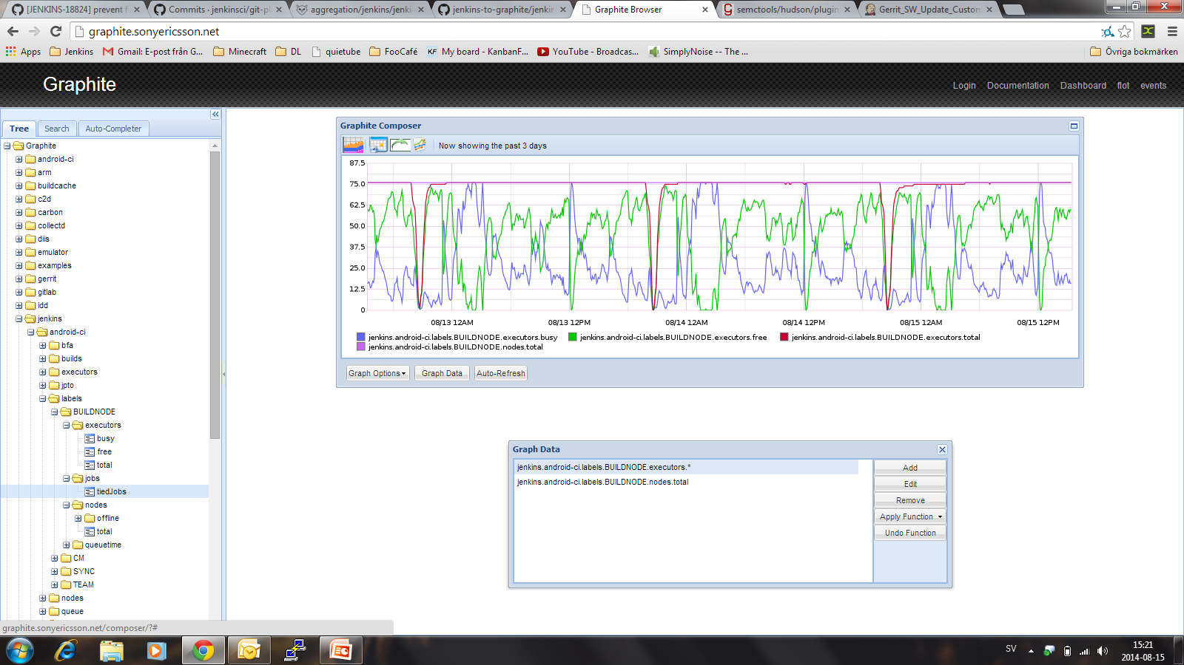
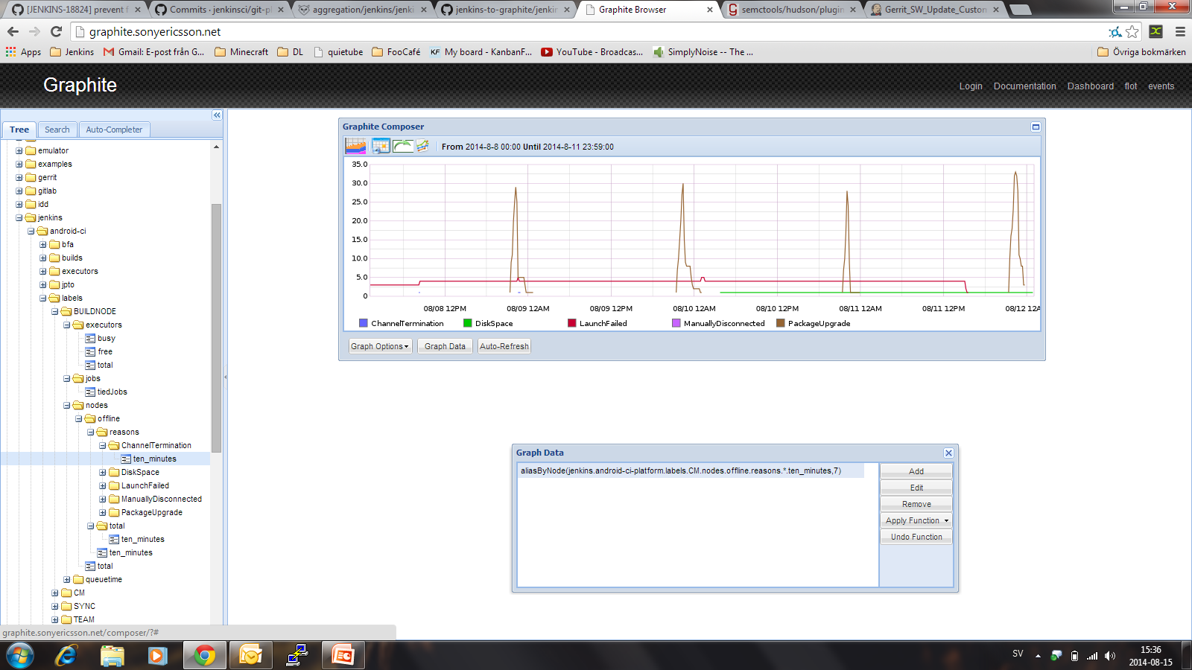
Offline/Available Slaves
Enhancement from last year: https://github.com/rsandell/getting-groovy-with-jenkins/blob/master/src/main/groovy/step2/offline_slaves.groovy Plus https://github.com/katzj/jenkins-to-graphite

Slide 11
Build Failure Analyzer

